Slide 1





Micro and Macro Level Graph Modeling for Graph Variational Auto-Encoders
Kiarash Zahirnia, Oliver Schulte, Parmis Naddaf, Ke Li
School of Computing Science, Simon Fraser University, Vancouver, Canada
NeurIPS 2022
Notes:
Share · SlidesLive Recorder
Hi everyone, Thank you for watching our video.
I am Kiarash and presenting our paper , Micro and Macro Level Graph Modeling for Graph Variational Auto-Encoders.
In collaboration with ke and Oliver my suppervaser and my colab parmis

Slide 2
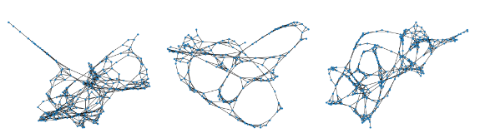
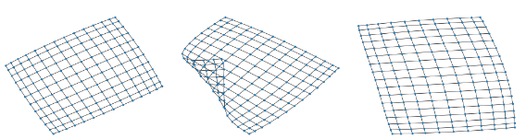
Graph
Problem Definition
Introduction
𝒢 = (V, E) is a pair comprising a finite set of |V|=N nodes and |E| edges.
A graph can be represented by an adjacency matrix A.
Given a set of observed graphs G = {𝒢₁, ...𝒢_{S} } sampled from data distribution p(G), the goal of learning generative models for graphs is to learn the distribution of p_{θ} (G) which is similar to p(G).
The focus of this paper is on models for generating “realistic-looking” graphs.
Samples from Protein dataset (real data).
Samples from Grid dataset (synthetic benchmark).
Notes:
.
Given a set of observed graphs sampled from a ditribution, the goal of GGM is to learn the distribution of p_{θ} (G) which is similar to true/original data distribution
In this paper we focus on capturing the graph structure
The citation for evaluation metrics
Big picture

Slide 3
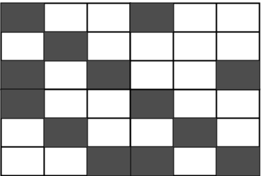
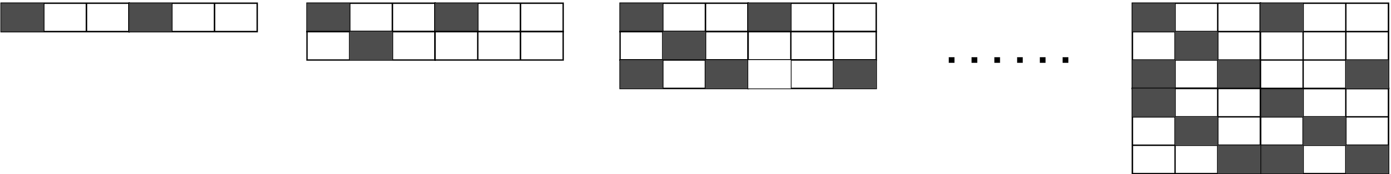
Deep Graph Generative Models (GGMs)
Related Work
1) All-at-once Models
Generate a graph, adjacency matrix, in one-shot.
2) Autoregressive Models
Generate a graph sequentially, an edge, node, or block at a time.
VGAE(Kipf et al 2018)
MolGAN (Cao et al 2018)
GraphVAE (Dai et al 2018)
GraphRNN (You et al 2018)
GRAN (Liao et al 2019)
BiGG (Dai et al 2020)
All-at-once models have fast and tractable sampling and relatively stable training.
Sequential graph generation allows autoregressive models to capture complex dependencies between new edges/nodes and edges/nodes already generated.
Notes:
GGM models categories into two categories based on the approach which they exploit for graph generation
ll-at-once generation generates a graph , generally the adj matrix in one shoot. Auto-regressive methods on the other hand generate a graph incrementally.
All-at-once methods are faster at graph generation, but tend to generate less realistic graphs.
/—---------------------------------------------------------------------------------------
ll-at-once approaches have fast and tractable sampling and relatively stable training but tend produce poor generative performances [cite].
On the other hand, auto-regressive models generate graph sequentially, which allows them to capture complex dependencies between a new edge and edges already generated.

Slide 4
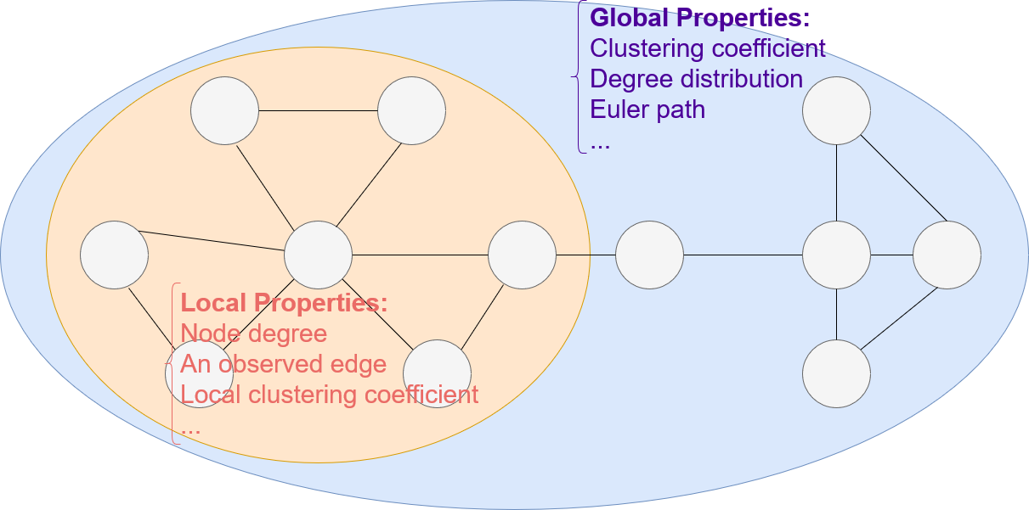
Global and Local Graph Properties
Motivation
Two levels of information:
1) Local node-level properties
2) Global graph-level properties
Most deep GGMs are trained with an objective based on local properties.
Local properties does not model different edge roles in the graph global structure.
Notes:
t is common in graph analysis to distinguish two levels of information [ 10, 20 ]: (1) local node-level properties, such as
the existence of a link between two nodes or the node degree[ 27 , 37 , 19 ], and (2) global
graph-level statistics that depend on the entire graph, such as node degree
distribution or motif counts
Most deep GGMs are trained with an objective based on local properties (generaly , maximizing the probabilities of observed edges
Edges in a graph have different rolde and local properties can not capture different edges role in graph

Slide 5
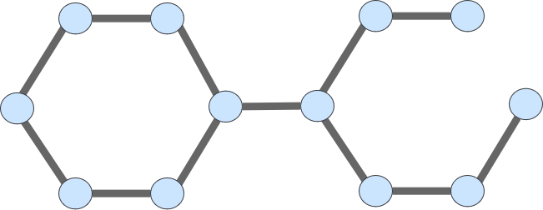
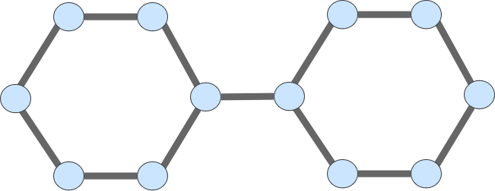
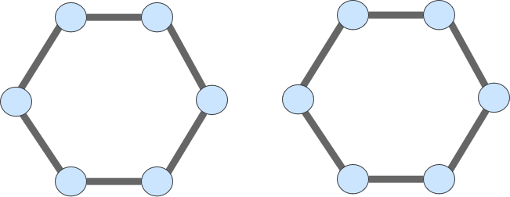
Global and Local Graph Properties (example)
Motivation
Generated Graph 1
Original Graph
The two right graphs score the same in terms of number of reconstructed edges, however the Graph 1, is structurally more similar to the Original Graph.
Generated Graph 2
Notes:
The figure illustrate the difference between local and global properties.
The two right
graphs (1b), (1c) score the same in terms of number of edges reconstructed from the left graph , a
local node-level property. However the right graph 1, is structurally more similar to original graph and, contains
the same number of connected components, a global graph-level statistic
Some edges play a critical role for the connectivity/community structure,
while others are less important. Previous GGM training is generally based on a likelihood objective
that decomposes into individual edge likelihoods [ 47, 31, 11], and cannot capture the different role
of edges. Graph global level information on the other hand can capture the different edge roles to
measure the importance of an edge in the graph structure (see also Section 4).
To illustrate the difference between local and global properties. The two right
graphs (1b), (1c) score the same in terms of number of edges reconstructed from the left graph , a
local node-level property. However the right graph 1, is structurally more similar to original graph and, contains
the same number of connected components, a global graph-level statistic

Slide 6
Learning objectives
The proposed model
Graph generative models
Matching global graph-level properties
Matching local node-level properties
Exponential random graph models
This paper
Deep GGMs
Notes:
We introduce a new micro-macro training objective for graph generation that combines node-level and graph-level losses..

Slide 7
Approach
The proposed model
Micro-macro (MM) Modeling:
A principled probabilistic framework that incorporates both local (Micro) and global (Macro) graph properties.
Notes:
In fact we proposes a new multi-level framework that jointly models node-level and graph-level properties , as mutually reinforcing sources of information.

Slide 8

Approach
The proposed model
L⁰ : micro loss.
L¹ : macro loss.
A: training graph.
m: number of global properties.
F_{u}: random variable defined by φ_{u}(A).
𝜸: hyperparameter.
Micro-macro (MM) Modeling:
A principled probabilistic framework that incorporates both local (Micro) and global (Macro) graph properties.
Assuming a predefined finite set of graph global statistics/properties, calculated by φ₁(), …, φ_{m}() micro-macro loss is of the form:
Notes:
Assuming a predefined finite set of graph global statistics, defined by φ₁, … , φ_{m}, Micro-macro loss is of this form:
where A is the training graph and F u, u = 1, . . . , m is a random variable (defined by applying the
phi function to the training graph).

Slide 9
Approach
The proposed model
L⁰ : micro loss.
L¹ : macro loss.
A: training graph.
m: number of global properties.
F_{u}: random variable defined by φ_{u}(Â).
𝜸: hyperparameter.
Micro-macro (MM) Modeling:
A principled probabilistic framework that incorporates both local (Micro) and global (Macro) graph properties.
Assuming a predefined finite set of graph global statistics/properties, calculated by φ₁(), …, φ_{m}() micro-macro loss is of the form:
Advantages:
Realism: Compared to objective functions that are based on predicting local properties, matching graph statistics serves as a regularizer that increases the realism of the generated graph structures
User control: the user only needs to specify the target graph statistics and learning will automatically select graph models that match them.
Notes:
Advantages Micro-macro modeling increases graph realism and user control. (1) Compared to
objective functions that are based on predicting local properties, matching graph statistics serves
as a regularizer that increases the realism of the generated graph structures. This is sufficient to
generate realistic graphs with a fast all-at-once edge-parallel model. (2) O’Bray et al. [35] note that
different graph statistics are important for different applications. For example for a large payment
graph recording economic transactions, a macro economist may be mainly interested in the average
price level of a target goods basket. For a central bank managing a payment system, the total number
of transactions may be more important. O’Bray et al. [35] therefore advise selecting a GGM based
on the graph statistics of interest in the target application. However, this entails searching through
the space of GGMs and their hyperparameters to find a good match with target graph statistics.
In our MM framework, the user only needs to specify the target graph statistics and learning will
automatically select graph models that match them.

Slide 10


GraphVAE-MM
The proposed model
L⁰ : micro loss.
L¹ : macro loss.
A: training graph.
Ã: underlying probabilistic adjacency matrix.
F_{u}: random variable defined by φ_{u}(A).
𝜸: hyperparameter.
z: graph embedding.
Ã_{z}: probabilistic adjacency matrix computed as a function of graph embedding z.
m: number of target statistic.
|F_{u}|: dimensionality of target statistic F_{u}.
This paper works with negative log-likelihood losses:
Notes:
In this paper we work with negative log-likelihood losses and a variational approximation based
on an encoder-decoder architecture

Slide 11
GraphVAE-MM
The proposed model
L⁰ : micro loss.
L¹ : macro loss.
A: training graph.
Ã: underlying probabilistic adjacency matrix.
F_{u}: random variable defined by φ_{u}(A).
𝜸: hyperparameter.
z: graph embedding.
Ã_{z}: probabilistic adjacency matrix computed as a function of graph embedding z.
m: number of global properties.
|F_{u}|: dimensionality of target statistic F_{u}.
This paper works with negative log-likelihood losses:
By approximating with variational Lower bound we have:
Notes:
In this paper we work with negative log-likelihood losses and a variational approximation based
on an encoder-decoder architecture
A MM objective that can be used with graph encoder-decoder models is derived as
an ELBO from the joint probability model.ining objective.

Slide 12
Graph Statistics
The proposed model
GraphVAE-MM: We utilize the micro-macro objective to improve graph generation with a GraphVAE (Dai et al 2018) architecture.
Notes:
We utilize the micro-macro objective to improve graph generation with a GraphVAE, a well-established model based on graph-level latent variables, that provides fast training and generation time for medium-sized graphs.
We therefore follow an a design where we utilize graphVAE architecture
Aas it is and change only the training objective.

Slide 13
Graph Statistics
The proposed model
GraphVAE-MM: We utilize the micro-macro objective to improve graph generation with a GraphVAE (Dai et al 2018) architecture.
In our experiments, we utilize 3 default global graph-level properties::
Degree histogram
Number of triangles
S-Step transition probability for S=2,...,5
Notes:
In our experiments, we utilize as aph global properties for regularizing graph embeddings:
Degree histogram
Number of triangles
S-Step transition probability for S=2,...,5

Slide 14
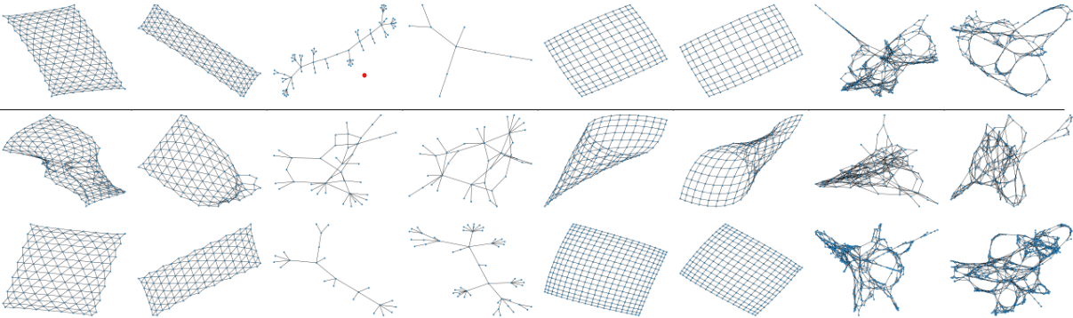
Qualitative Evaluation
Experiments
Triangle Grid
Lobster
Grid
Protein
Test
GraphVAE
GraphVAE-MM
GraphVAE–MM achieves much better visual match than GraphVAE.
Notes:
We do expensive experiment on both synthetic benchmark and real word data
The figure visualize the effect of MM modeling.
First row shows randomly selected
graphs from the test set for each dataset, the other rows show graphs generated by graphVAE with and without mm modeling
Micro-macro (MM) modeling greatly improved the quality of graphs generated by GraphVAE

Slide 15
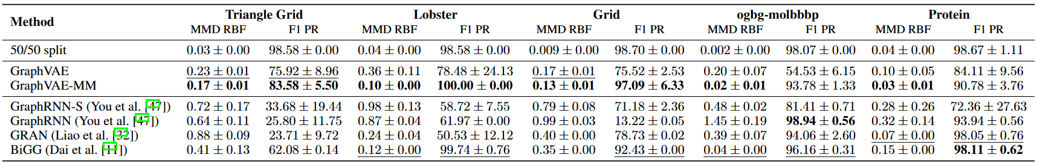
Quantitative Evaluation (GNN-based evaluation metrics Thompson et al 2022)
Experiments
MMD RBF and F1 PR capture the reality and diversity of generated graphs, respectively.
Impact on GraphVAE. MM modeling provides a large improvement in the realism and diversity of graphs generated by a GraphVAE architecture.
GraphVAE-MM vs. Benchmark GGMs. Micro-macro (MM) modeling greatly improved the GraphVAE, to match or exceed that of benchmark models.
Notes:
GNN-based evaluation also shows that Micro-macro (MM) modeling greatly improved the quality of graphs generated by GraphVAE, to
match or exceed that of benchmark models

Slide 16
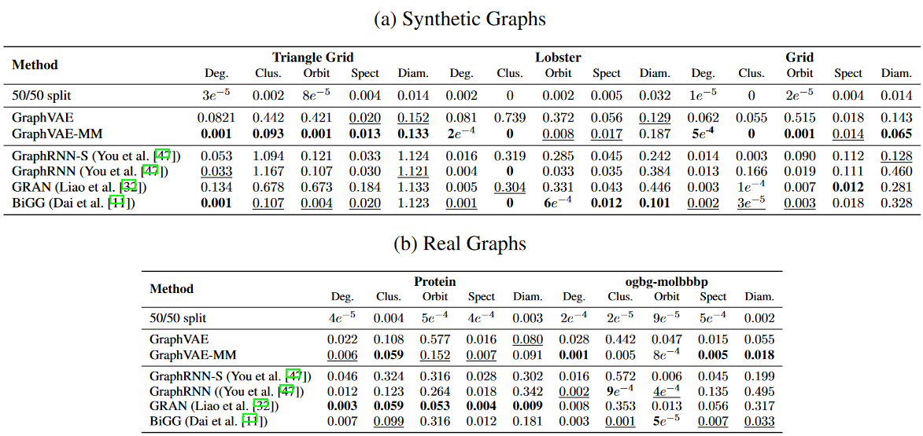
Quantitative Evaluation (statistic-based evaluation metrics O’Bray et al 2022)
Experiments
Statistic-based evaluation of micro-macro modeling shows MM modeling improves the reality of graphs generated by GraphVAE, up to 2 orders of magnitude on five benchmark datasets.
Notes:
statistic -based evaluation of micro-macro modeling for GraphVAE also shows that MM modeling improves the reality of graphs generated by GraphVAE, up to 2 orders of magnitude on five benchmark datasets.
, Graph VAE-mm matches or exceed that of benchmark models.

Slide 17
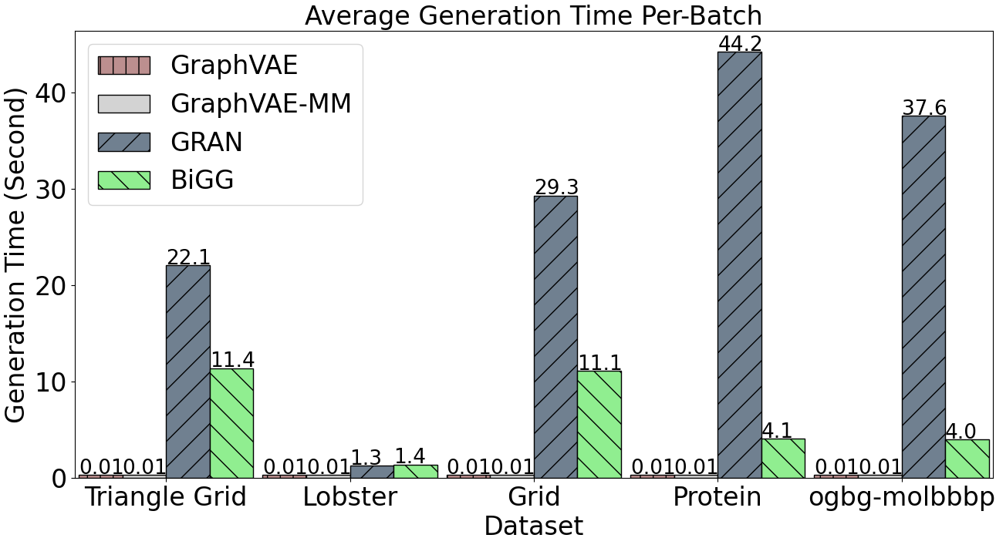
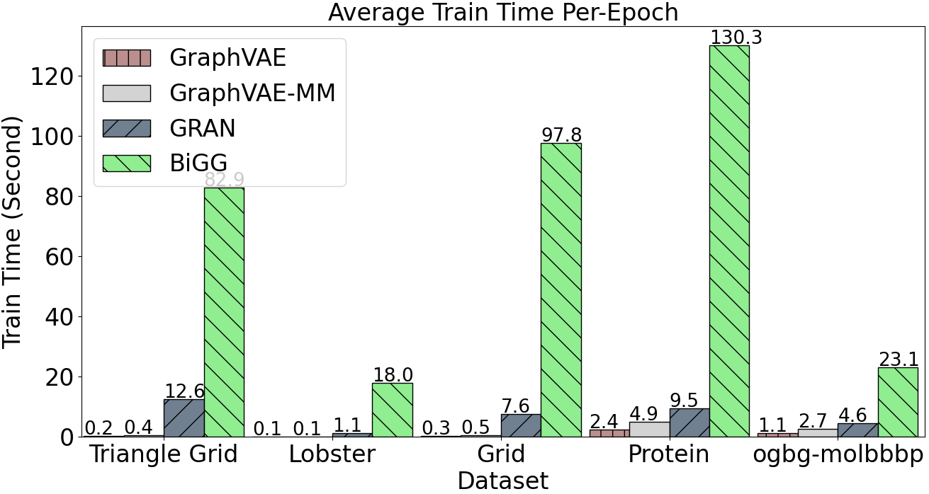
Generation and Train Time
Experiments
Generation time. The autoregressive methods require substantially more generation time.
Training time overhead. The training time is still less than for the autoregressive methods.
Notes:
We also compare the gen and train time of GGM models
The left figure compares GraphVAEs to the fastest auto-regressive methods. As illustrated The auto-regressive methods require substantially more generation time than GraphVAEs
The right figure compare the models training time. While MM modeling slow down training, for the GraphVAE, the training time is still less than for the auto-regressive methods

Slide 18
Conclusion
This paper proposes a new multi-level framework that jointly models node-level properties and graph-level properties, as mutually reinforcing sources of information.
We derive a joint ELBO as a new micro-macro objective function for training graph encoder-decoder models.
Our experiments show that adding micro-macro modeling to the GraphVAE model improves graph quality scores up to 2 orders of magnitude while maintaining the GraphVAE generation speed advantage.
Notes:
Our experiments show that adding micro-macro modeling to the GraphVAE model
improves graph quality scores up to 2 orders of magnitude on five benchmark
datasets, while maintaining the GraphVAE generation speed advantage
MM modeling improves graph quality scores up to 2 orders of magnitude on five benchmark datasets.
MM modeling improves the quality of graphs generated by GraphVAE, to match or exceed that of benchmark.
You can always reach out to me for any question

